Slide 1

Fake stories: Conspiracy theories
Did you know:
Project Real was created by young people, teachers, university academics and influencers

Slide 2
Aims
Understand why people might create/share conspiracy theories
Explore how to spot conspiracy theories online (e.g., in headlines)
Explore the potentially negative impact of conspiracy beliefs

Slide 3
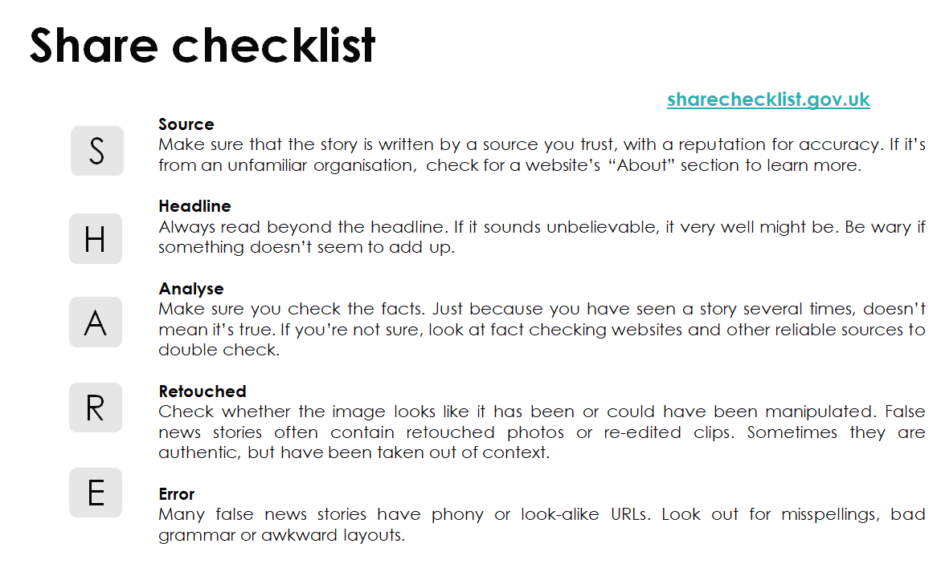

Slide 4
Starter: What is a conspiracy theory?
A conspiracy theory is …
an attempt to explain the ultimate causes of important events as secret plots by powerful groups.
What conspiracy theories have you heard of?
This can include ones related to your hobbies and interests.
Notes:
As a starter, you can ask the students if they know what a conspiracy theory is – a definition is on the slide (and will appear when you click the mouse). Next, ask students what conspiracy theories they have heard of, and prompt them to think about any related to their hobbies (e.g., there are a lot of conspiracy theories in football). You could get them to have a paired or full class discussion about this (5 minutes).

Slide 5

Think about…
Do you think that conspiracy theories are new?
Think about…
Is it human nature to want interesting and (maybe) controversial stories to surround big events?
Notes:
Before a short video, ask the students in pairs/small groups/as a whole class to think about the two questions on the slide (are conspiracy theories new; human nature). Get students to feedback to you before playing the video on the next slide (5 minutes).

Slide 6
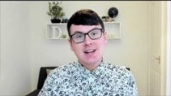
What is a conspiracy theory? Video by Dr Daniel Jolley
Notes:
5min 40 secs
https://www.youtube.com/watch?v=1FoOlFTt274

Slide 7
Main activity: Making
In pairs/groups, we want you to write:
your own conspiracy theory about whatever topic interests you.
a fake news story about the same topic, but that is not conspiracy based.
You will be asked to share both with your peers, and they will try and spot which one is the conspiracy theory.
Remember to use what you have learnt from Daniel on what makes a conspiracy theory!
Notes:
The main activity involves students working in pairs/small groups to write their own conspiracy theories based on whatever topic interests them. They will also be asked to write a fake news story. Encourage students to use the key ingredients that Daniel spoke about in his video (i.e., the conspiracy needs to be about a large event/issue, where something is being hidden/kept in secret, by a powerful group). Students will be asked to share their conspiracy/fake news story with another group. The task will be whether the other group can spot the conspiracy.
Depending on your class dynamic, you could have groups submit them to you to read out – the class could then vote (hands up) which one out of the pair is a conspiracy. (25 minutes for both making and spotting)

Slide 8
Here’s an example
Which one is the conspiracy theory? (and why?)
The famous music artist, Beyonce, is a robot and this is covered up by the powerful music industry to keep making money.
An unknown music artist can dance so well because they drink bubble-gum ice-cream every day.
Answer: Beyonce (1st one) would be defined as a conspiracy theory!
Make sure you look out for key ingredients – big event/topic (Beyonce – a celebrity!!); in secret (covered up!!); powerful group (powerful music industry!!).
Notes:
If the students are struggling for inspiration, there is an example of a conspiracy vs. fake news. If the students appear to understand the task, you might not need to show this! At the bottom of the slide, some tips highlight why the ‘Beyonce’ one is a conspiracy theory (custom animation).
The students only need to write one or two sentences for their conspiracy and their fake news story

Slide 9
Main activity: Spotting
Swap
Swap your stories (one fake, one conspiracy) with another group.
Now it is time to spot which one is the conspiracy theory?
Spot
When spotting the conspiracy, look for the key ingredients in the headline (e.g., secret groups, big event).
Can you spot which one is the conspiracy theory?
Notes:
Teachers:
You can ask them to swap with another group
Read/present their conspiracy vs fake news – which one is the conspiracy?
Or you can read them out if they are feeling shy!

Slide 10
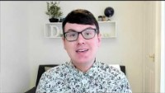
Why should we care about conspiracy theories? Video by Dr Daniel Jolley
Notes:
2 min 40
https://www.youtube.com/watch?v=yvytF2sdkI8

Slide 11
Closing Activity
What harm might have been caused if someone believed your conspiracy theory?
What harm might have been caused if people believed other conspiracy theories you have heard of?
Notes:
As a closing activity, have the students in pairs/small groups/ class discuss the questions on the slide. These will follow from the video on the consequences of conspiracy theories. Have students think about the consequences of the conspiracy they made up – for example Beyonce one, it could potentially increase mistrust in the music industry; if people believe that Beyonce is a robot, could they stop buying her music? Could the conspiracy beliefs lead to negativity towards Beyonce? Of course – mundane example, but you could highlight if the students are struggling a little. (10 mins)

Slide 12
Summary
Today you have learned:
Why people might create/share conspiracy theories
How to spot conspiracy theories online (e.g., in headlines)
The potentially negative impact of conspiracy beliefs

Slide 13
Links to our learning
Notes:
Please fill in this slide if required to show how this session may link to other subjects and sessions

Slide 14
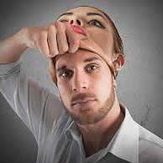
Next week…
FAKE VIDEOS
A session looking specifically at edited and fake videos

